Slide 1
Create a Google account

Slide 2
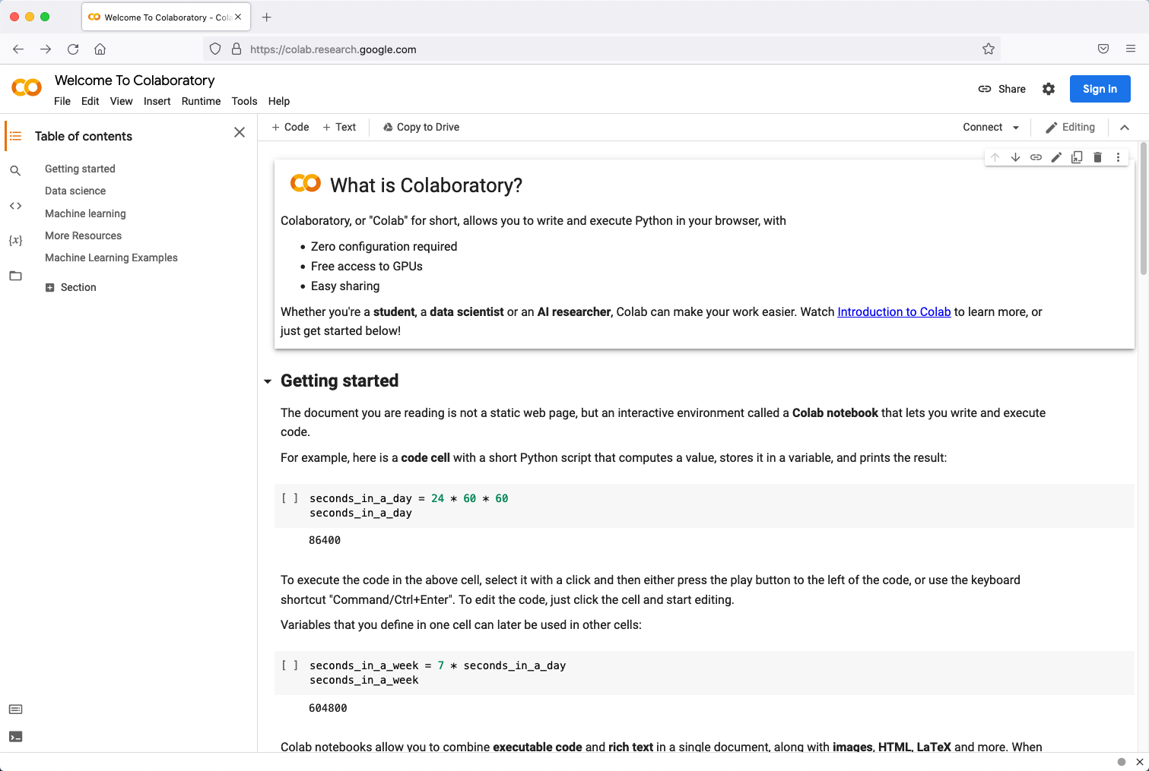
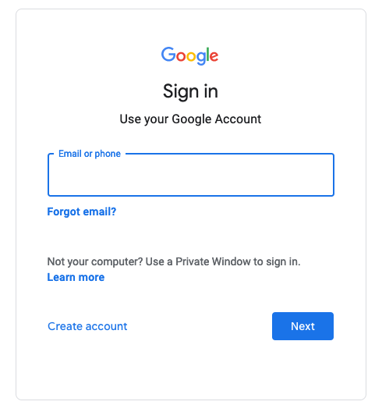
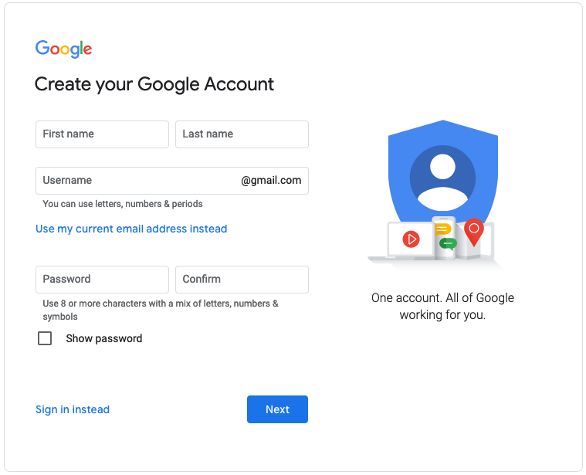
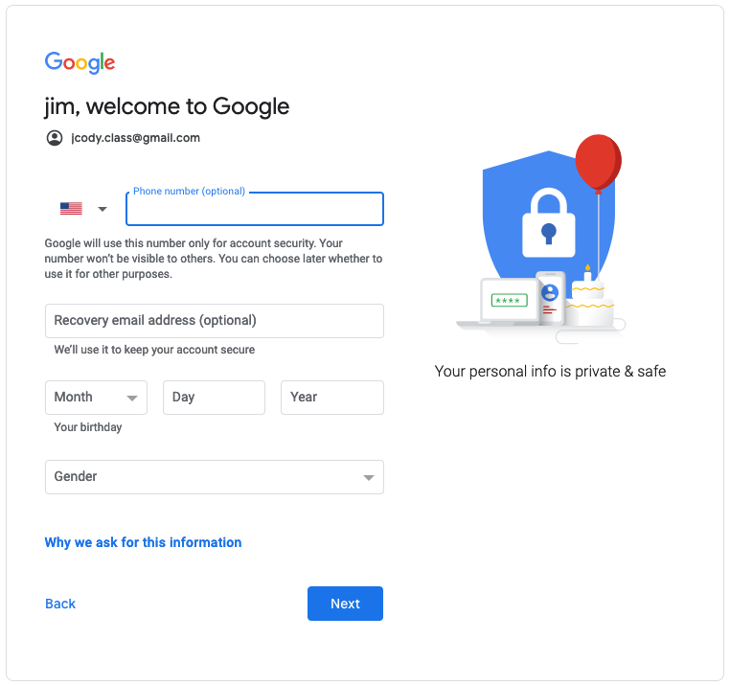
Create a google account
Start at https://colab.research.google.com/
Click on ‘Sign In’
Create account
On Create page, add username and pwd
Add final information
Go to Google CoLab!

